Slide 1

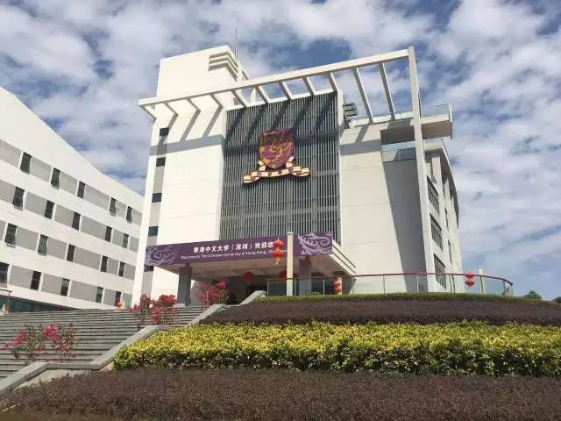
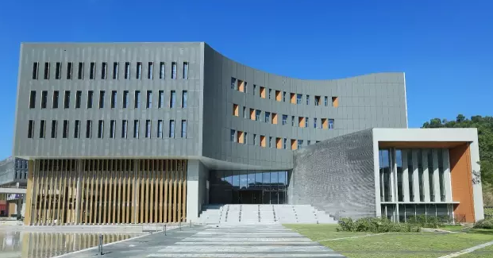
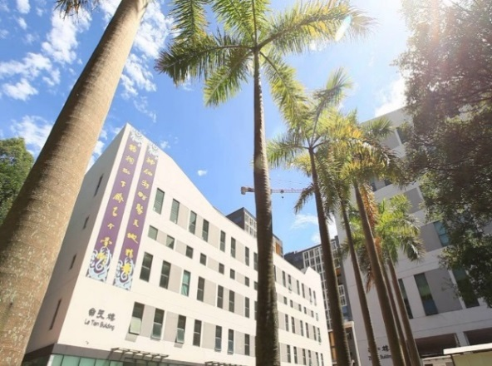
Large-Area Super-Resolution 3D Digital Maps for
Indoor and Outdoor Wireless Channel Modeling
Qianyu Zhang, Guanchong Niu and Man-On Pun
The Chinese University of Hong Kong, Shenzhen
Jun 4, 2018

Slide 2
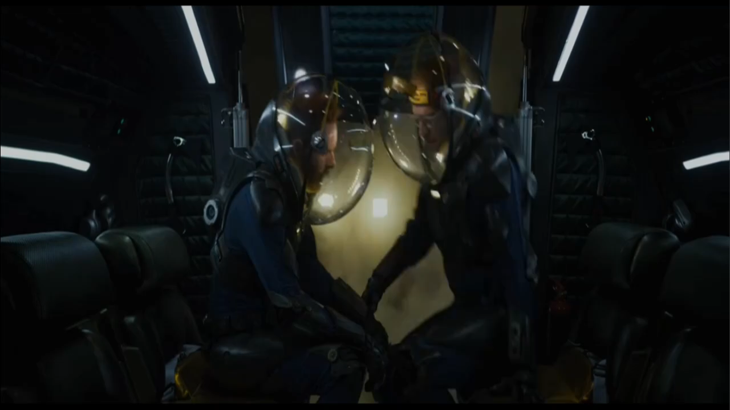
Turning Scientific Fiction into Reality

Slide 3
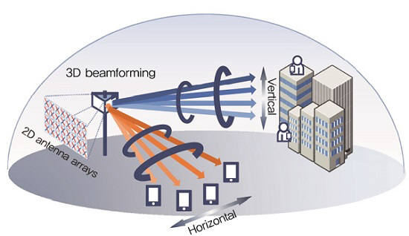
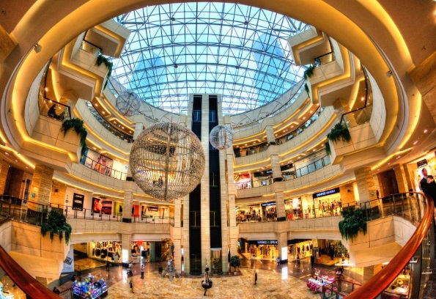
Better Channel Models for 5G
Ultra-dense networks
3D channel models for full-dimension massive MIMO beamforming
Indoor channel models for mobile users residing inside buildings
Channel models in the millimeter wave spectrum
Vehicle-to-Vehicle (V2V) channel models
Channel models for the Unmanned Aerial Vehicle (UAV)-ground links

Slide 4
Network Planning and Optimization
In particular, channel models are critical in network planning.
Initial network configuration
Signal Coverage Prediction
Ray Tracing-based
Channel models
All requirements satisfied ?
No
Network Configuration Optimization
Coverage holes, minimum SINR etc.
Yes
No
Field Measurement
via Drive Test
All requirements satisfied ?
Yes
End

Slide 5
Signal Coverage Prediction via Ray-Tracing
More accurate signal strength coverage maps

Slide 6
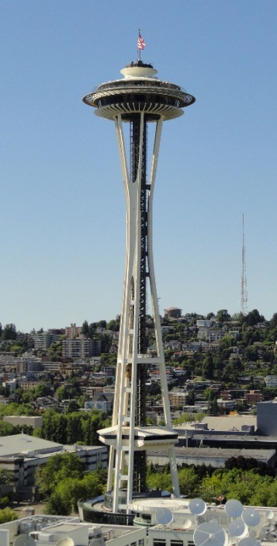
Limitations of Existing Maps
Generated from satellite imagery Cannot see through walls and roofs
Limitation | Problems in Channel Modeling | Reality
Lack of wall material information | One penetration loss model for all walls | Penetration loss varies substantially with wall material
Lack of indoor information | One indoor model for all: penetration + pathloss | Channels vary substantially inside buildings
Lack of building shape information | All buildings : polygonal cylinders | Buildings have different shapes
Expensive | Maps only available for the most popular markets | Coverage is also important for the 2nd-Tier markets
The Space Needle
Seattle, WA
Additional input: Digital elevation model (DEM), Digital Surface Models (DSM)

Slide 7
Super-Resolution 3D Digital Maps
 | Existing maps in the market | Our maps | Our enabling technology
Resolution | Up to 2m | A few centimeters (cm)! | Low altitude and close measurement of targeted terrestrial objects; high-precision sensors
Wall Materials | Unknown | Available (wood, concrete or glass etc.) | Sensors mounted on UAV can measurement wall reflectivities.
Environments | Outdoor only | Both indoor and outdoor | UAV can conduct measurement more efficiently and economically
Customization | Not available | Available upon request
Cost | For a metropolitan area of 1km², about US$8K | < half of the current price (expected) | Using UAVs to replace labor-intensive measurement

Slide 8
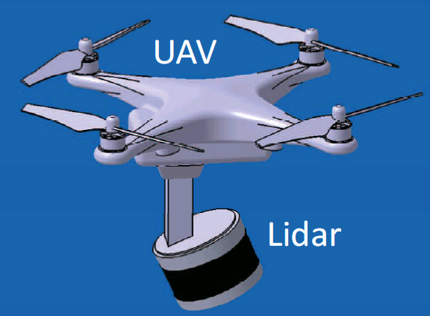
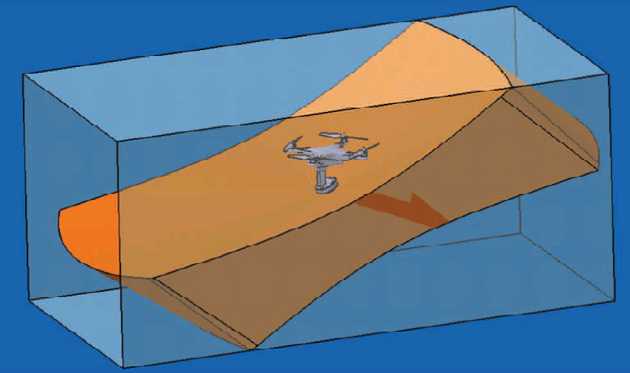
Proposed Surveying Systems
Quadcopter UAV
Smaller footprint to navigate through indoor and outdoor environments
Phantom 4 pro from DJI: 350mm in diagonal, max. speed 72km/h and max. altitude 500m
Measurement System
Tilted LiDAR
Data
Thorough scan without blind spots including ceilings
Off-line
Data Integration
Simultaneous Localization and Mapping (SLAM)
Super-resolution 3D models

Slide 9
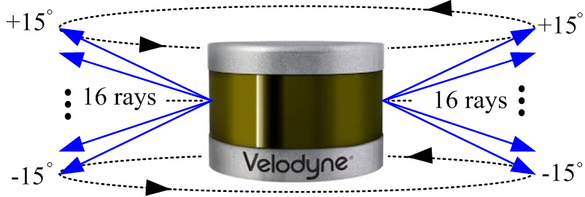
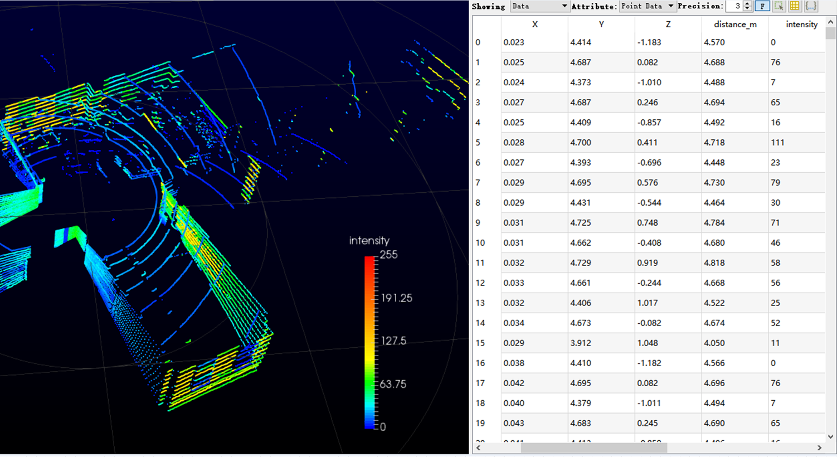
Velodyne VLP-16 LiDAR
Attributes | Values
Effective distance | 100m with of
accuracy | +/- 3cm
Laser/detector pairs | 16
Field of view (FOV) | 360° (Horizon.) /30°(Vertical)
Data | 300, 000 points per second
Rotational speed | 5-20 rotations per second
Angular resolution | Horizontal/Azimuth 0.1°~0.4°
Wavelength | 903 nm
Power Consumption | 8 W (Typical)
Weight | 830g
LiDAR data contains
Relative position (x,y,z)
Distance and
Calibrated reflectivity
Calibrated by Velodyne
“0” for absorbent diffuse reflectors while
“101” for a semi-transparent white surface.
A metal reflector will return a higher intensity value while glass 0.

Slide 10
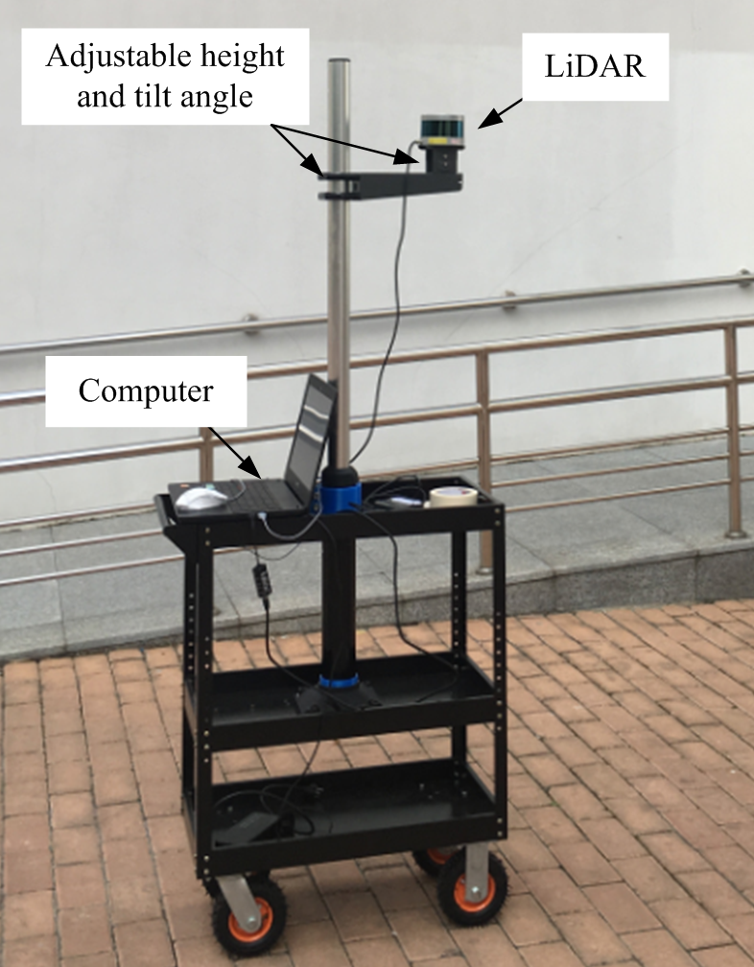
Prototype
LiDAR mounted on a pole fixed on a pushing cart
both height and tilt angle of the LiDAR adjustable → mimic the proposed LiDAR-bearing UAV without the risk of UAV crashes.
LiDAR is directly connected to a laptop running software package from Velodyne to collect LiDAR data before the data is processed by SLAM.

Slide 11
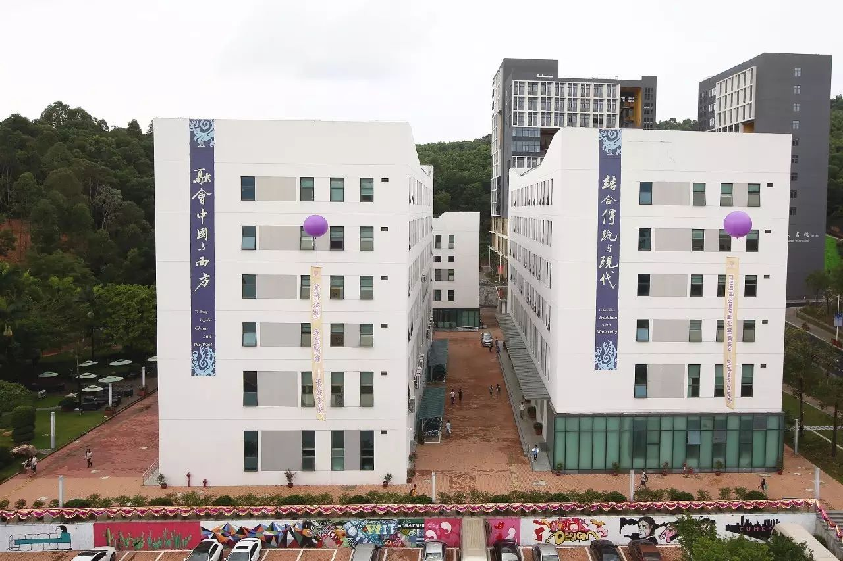
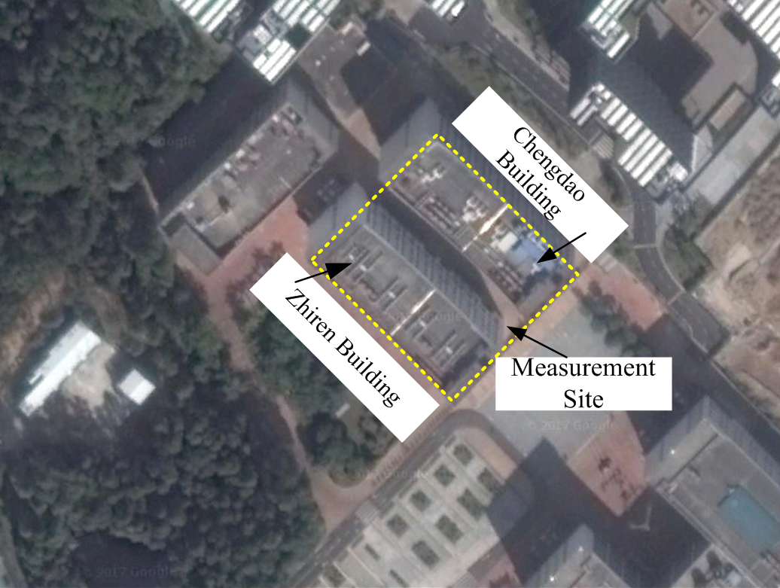
Measurement Sites: CUHKSZ Campus
Zhiren Building
Chengdao Building
13 m

Slide 12
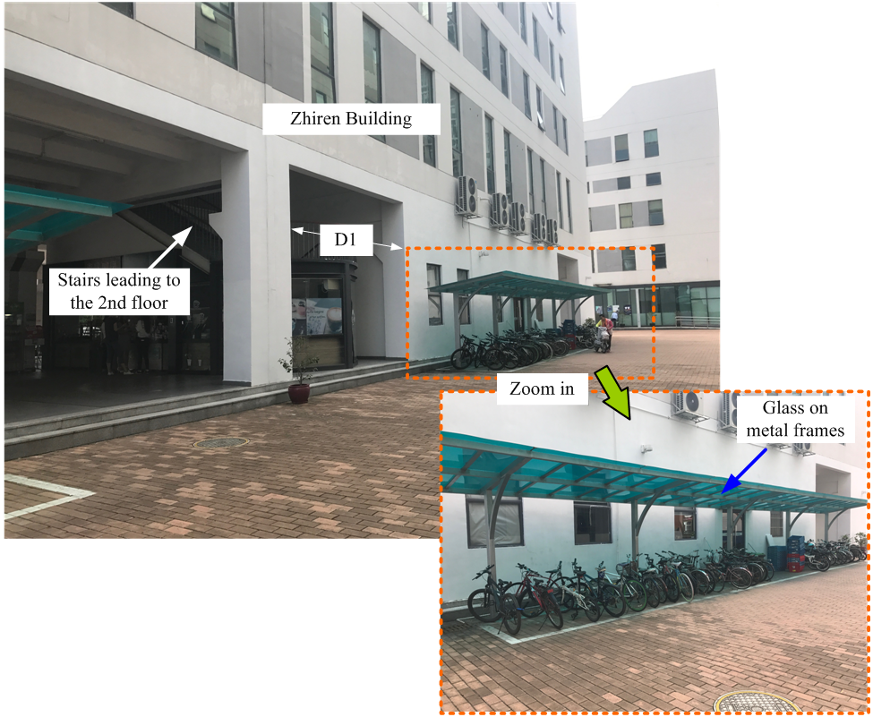
Measurement Site: Zhiren Building

Slide 13
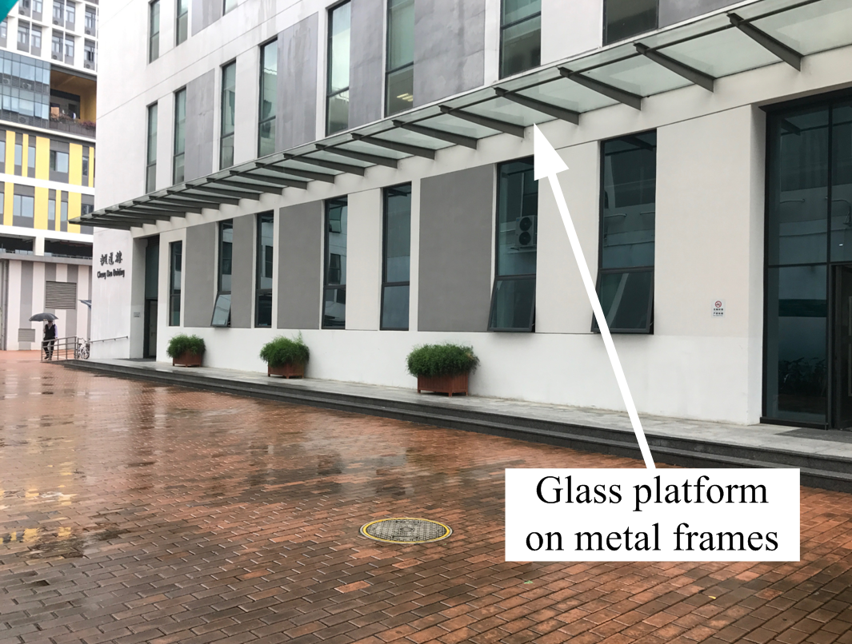
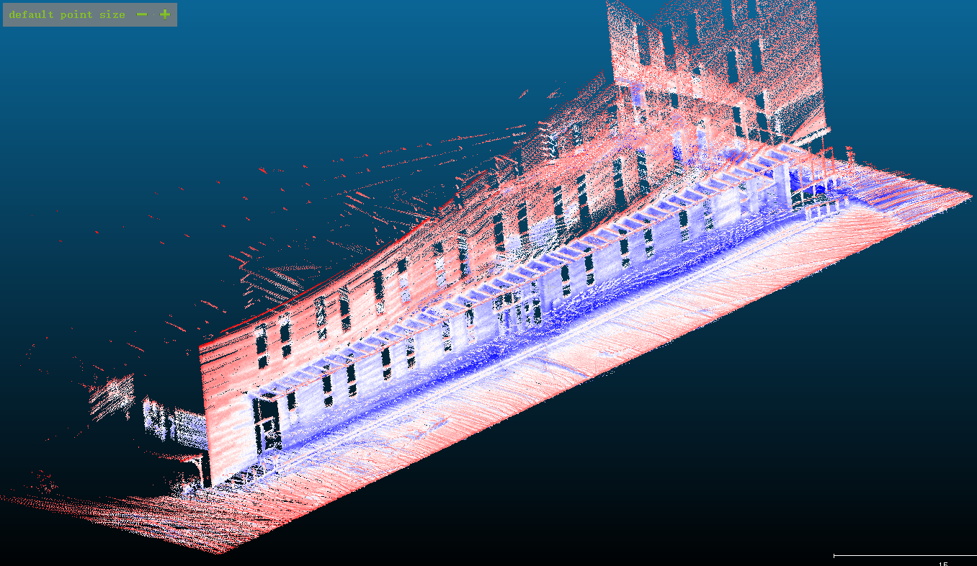
Measurement Site: Chengdao Building

Slide 14
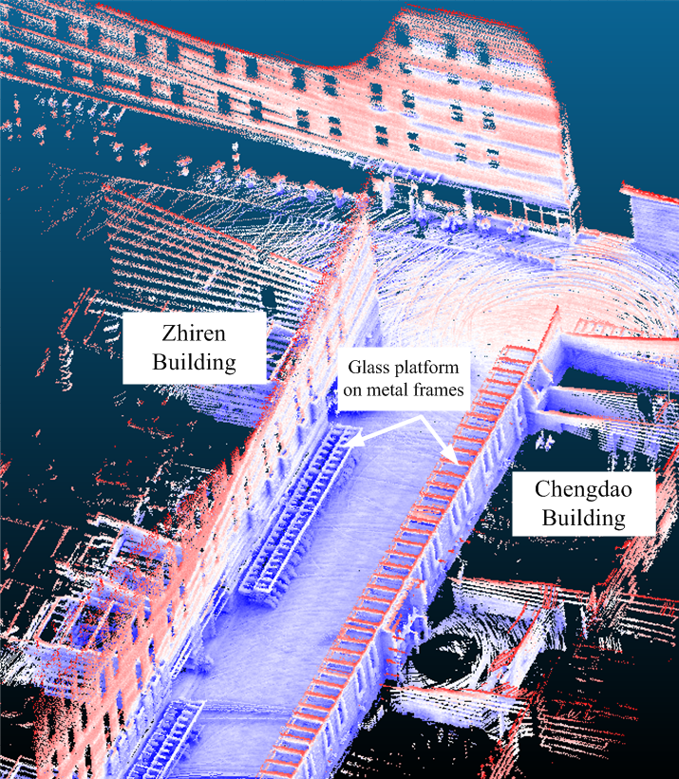
Initial Experimental Results (I) : Outdoor

Slide 15
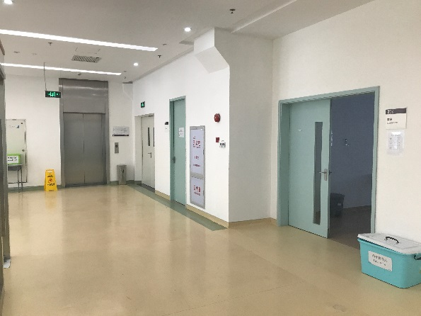
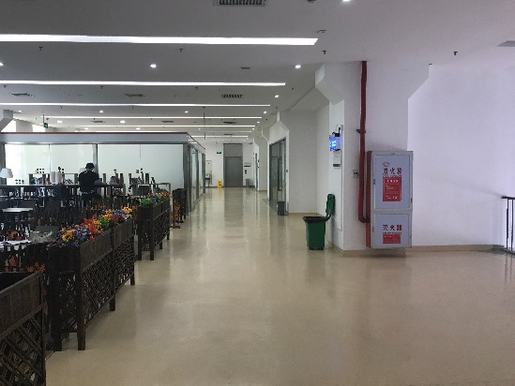
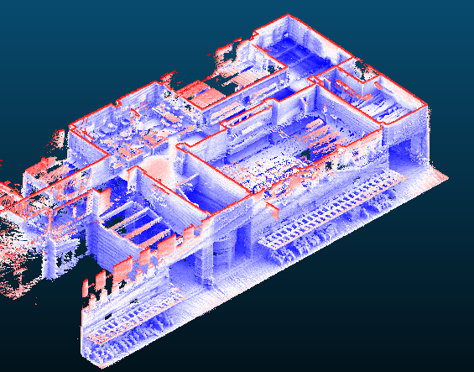
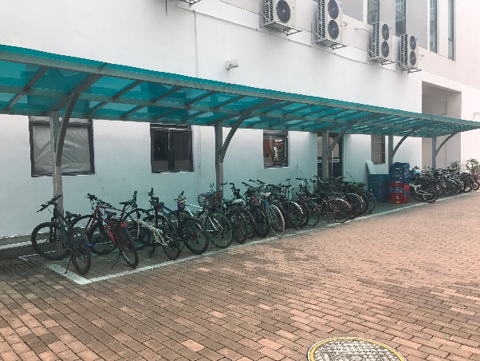
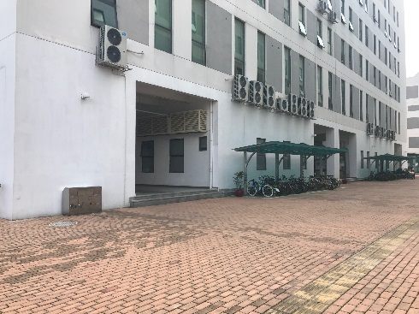
Initial Experimental Results (II)

Slide 16
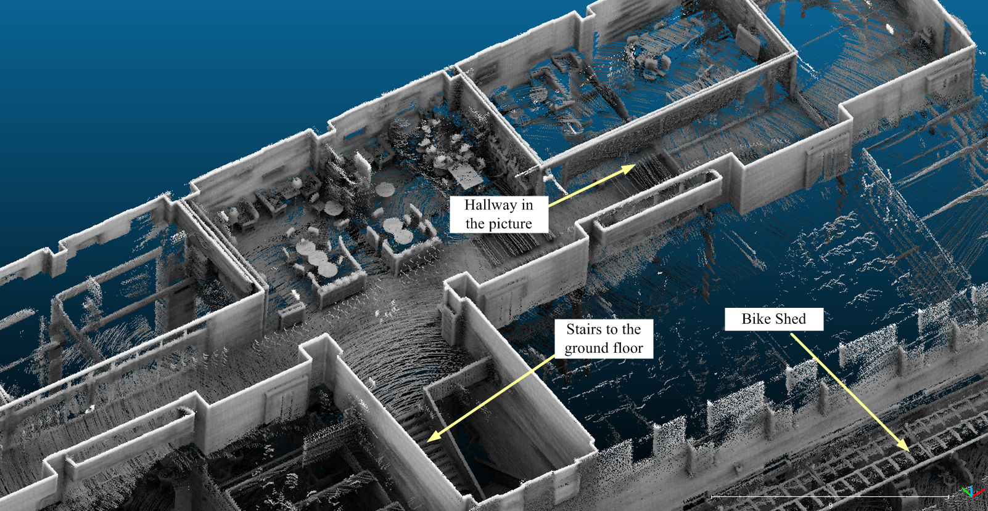
Initial Experimental Results (III) : Zoom In

Slide 17
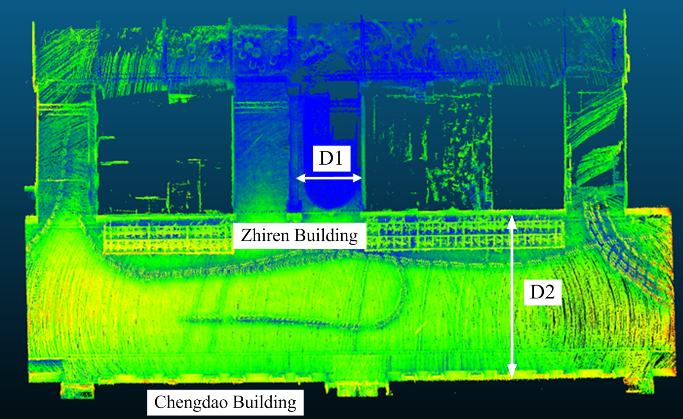
Measurement Accuracy
 | D1 (m) | D2 (m)
Laser distance meter | 13.026 | 5.886
Our results | 13.064 | 5.868
Accuracy | 99.7% | 99.7%

Slide 18
Conclusion
Proposed a UAV-based surveying system empowered by the latest technological breakthroughs in LiDAR, UAV and SLAM technology;
Implemented a simplified system prototype and conducted extensive indoor and outdoor measurements on our campus;
Preliminary results have confirmed the feasibility of our design of centimeter-order accuracy for both indoor and outdoor environments with some wall material information.

Slide 19
Future Works
Implementation of the UAV-based systems
Large enough to carry 1kg payload
Small enough to maneuver through indoor environment
Investigation on the relationship between intensity values and wall material.
Glass can be easily identified while other it is much more difficult to detect other types of material
Besides the wall material, the intensity value also depends on a few other factors such as colors, angles and distance.
Conversion from 3D models to 3D maps that are compatible with the existing ray-tracing tools.

Slide 20

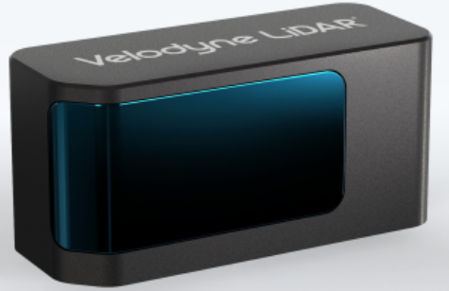
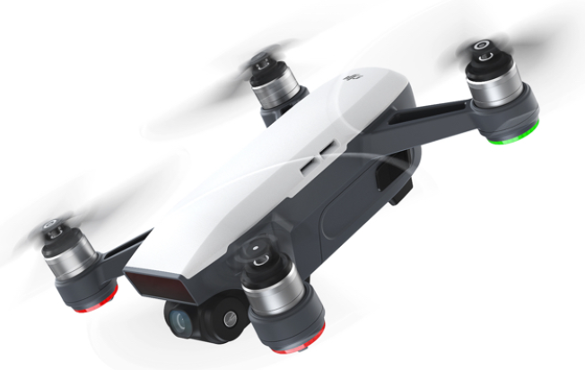
How Far We Are?
Bottleneck: Lidar
Velodyne Velarray Solid State Sensor
125mm x 50mm x 55mm
<US$1000
Bottleneck: UAV
Payload
Flight time (< 30 mins)
Wireless communications
SLAM
https://www.businesswire.com/news/home/20170419005516/en/Velodyne-LiDAR-Announces-New-

